Slide 1
WELCOME AND OVERVIEW

Slide 2
RING CEREMONY
RECAP
PICTURES IN SHOWCASE
KEEP THE TRADITION GOING
RING CARD

Slide 3
FUNDRAISERS
WHAT ARE THEY FOR
KRISPY KREME – GET YOUR ORDER FORM NOW
FOOD TRUCK FRENZY 4/18

Slide 4
PROM
TRYING TO KEEP TICKET PRICES TO $65.00 EACH
TAKE PART IN FUNDRAISERS
BWI MARRIOTT
7:30 – 11:30 PM

Slide 5
CLASS T SHIRTS
BUY ONE NOW - $15.00 EACH
IN MAY WE WILL HAVE PICTURE DAY IN THE ATRIUM
SEE MRS. FLOOD FOR YOUR SHIRT IN ROOM A141

Slide 6
MOVING UP FUN DAY
WE WILL TAKE THE PLACE OF THE SENIORS
DATE TBA
WAITING FOR SENIOR REHEARSAL SCHEDULE

Slide 7
Student services
Junior Interview Day – Tuesday, March 31st
Meets “World of Work” graduation requirement
Resume by March 6th

Slide 8
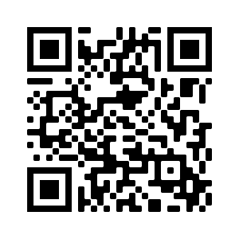
JR. Interview Professional dress
No jeans, tennis shoes, or sweat shirts will be permitted.
If you think you need to borrow clothes:

Slide 9
Service learning hours
Requirement to graduate – shows on your report card
Normally 75 hours (fewer if you transferred from out of state)
See your counselor with questions.

Slide 10
SAT and ACT
Next SAT dates: May 2 & June 6
Register at CollegeBoard.org
Next ACT dates: April 4 & June 13
Register at ACT.org

Slide 11
Dual enrollment for 12th grade
Interest meeting in April (stay tuned to announcements and Canvas for date)
Registration in May

Slide 12
QUESTIONS
REVIEW
JOIN US FOR OUR CLASS COUNCIL MEETINGS
MEETING DATES ARE LISTED ON BULLETIN BOARD AND SHOWCASE

